Slide 1
Surveying to Find the Impact of Breastfeeding on Later Academic Success in High School
Morgan Weaver

Slide 2
Background
My mom is a NICU nurse and always tries to present to the women she works with that breastfeeding is the best nutritional option for their children. I job shadowed my mom last year and talked to some of the moms who she works with, and they said they were aware of the nutritional benefits but thought if there were proven mental benefits it might be more persuasive.

Slide 3
Within the current senior class at Chapin High School, does each individual's mother breastfeeding them or not breastfeeding them correlate to their GPA, class rank, or SAT/ACT scores?

Slide 4
How is my study unique?
Effect on intelligence and schooling: For the assessment of performance in intelligence tests, we obtained data from eight studies that controlled for intellectual stimulation at home and collected information on infant feeding in infancy, in which the duration of breastfeeding was of at least one month among breastfed subjects. Performance in intelligence tests was higher among those subjects who had been breastfed (mean difference: 4.9; 95% CI: 2.97–6.92). Positive studies included a randomized trial. Regarding school performance in late adolescence or young adulthood, three studies showed a positive effect of breastfeeding.
Limitations: Because nearly all studies included in the analyses are observational, it is not possible to completely rule out the possibility that these results may be partly explained by self-selection of breastfeeding mothers or by residual confounding. Publication bias was assessed by examining the effect of study size on the estimates and was found not to be important for most outcomes. Very few studies were available from low/middle-income countries, where the effect of breastfeeding may be modified by social and cultural conditions.
Horta, B. L. (2007). Evidence on the long-term effects of breastfeeding: Systematic reviews and meta-analyses. Geneva: World Health Organization.http://apps.who.int/iris/bitstream/10665/43623/1/9789241595230_eng.pdf
Previous studies examined, and often found, a correlation between breastfeeding and high school success. However, these studies contained a lot of bias concerning social and cultural conditions. My study will have to do with one area, which is a strong control.

Slide 5
If the survey is run, then there will be a correlation found between whether or not the students were breast fed and their academic success.

Slide 6
Significance- Scientific Thought
This research could prove significant in the persuasion of women to breastfeed their children, which has been proven to be beneficial according to the World Health Organization(8).
An estimated 43% of children under 5 years of age in low- and middle-income countries – 249 million children – are at risk of not reaching their developmental potential, according to a new publication series from The Lancet(2).

Slide 7
The Science Behind
Closer relationship between mother and child (4)
Reducing mortality and morbidity from infectious diseases(7)
Nutrition during early phases of human development can alter organ function(3)
Increases the mean milean content of our brains(Brown University)
Why breastfeeding is so good for us

Slide 8
Design and Methodology
This project will be completed by surveying the senior class at Chapin High School. This survey will be administered during MAST, and students will be asked to go home and have their parent/guardian, preferably their mother, help them answer the questions on a date to be announced.. Students will be prompted again in MAST on a further date, perhaps a week later, to complete the survey. Students names will not asked for on the survey.

Slide 9
Variables and Controls
Controls: all students are in the same class, live in the same area, attend the same high school
Independent: the survey
Dependent: survey results

Slide 10
Data Collection
50+ Data Points Collected!!!

Slide 11
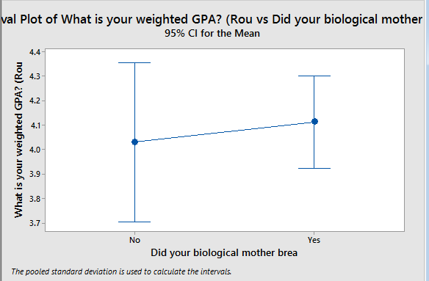
GPA

Slide 12
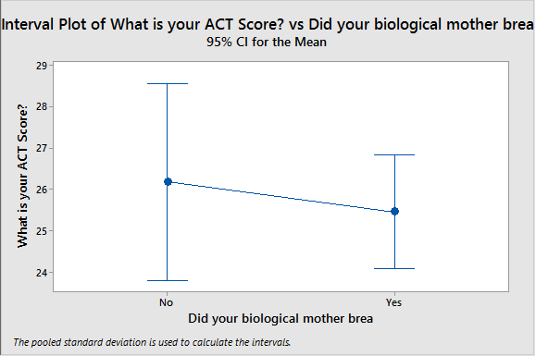
ACT Scores

Slide 13
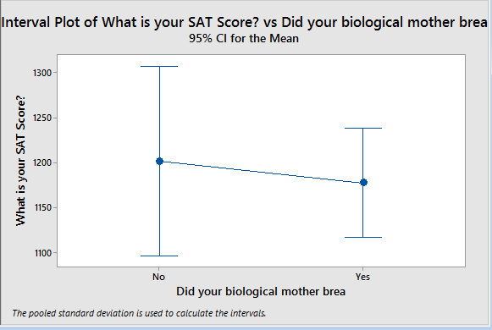
SAT Scores

Slide 14
Data Analysis
I used an ANOVA statistical analysis test in order to examine my data. ANOVA tests compare the means of the data based on its grouping. In the SAT(1210 vs. 1170)and ACT(26.3 vs. 25.7) score results, the mean scores were actually higher for those who were not breastfed. However, in the GPA results, the mean GPA was higher for those who were breastfed(4.03 vs. 4.09).

Slide 15
Interpretation
This is interesting because it might be due to children whose mothers breastfed them also might be more likely to “hover” over their grades.

Slide 16
Conclusion
While the survey given had many questions, that was simply to throw students off so they couldn’t nail down exactly what was being tested. In the final data calculations, I used an ANOVA test to find if there were any statistically significant differences between the means of three or more independent (unrelated) groups of whether or not a student was breastfed and then their GPA, ACT score, and SAT score. This test found that while we reject the hypothesis, meaning there is not significant data for the ACT or SAT scores, there is enough significance to accept the alternative hypothesis, that there is a correlation, between whether or not a student was breastfed and their GPA. This project's impact is that it has the ability to go on and convince women that there are other benefits aside from the nutritional aide that breastfeeding can offer their infants, even later on in life.

Slide 17
Contribution to Field
My hopes for this survey is that the results will be able to be used as a source to cite to convince women to breastfeed their children.

Slide 18
Similar Studies
Der Geoff, Batty G David, Deary Ian J. Effect of breastfeeding on intelligence in children: prospective study, sibling pairs analysis, and meta-analysis BMJ 2006; 333 :945
This study examined the relation between breastfeeding and intelligence and assessed the role of maternal IQ and other covariates in generating the association. They took both a conventional approach to control for confounders and an alternative approach using sibling comparison analysis. Used recently to assess the benefits of breastfeeding,10 this approach has the considerable advantage of controlling for many confounding factors without having to measure them. Any factor that is the same for both members of a pair of siblings is automatically and fully controlled for. Thus, the method implicitly controls for parental intelligence.
Mortensen E, Michaelsen K, Sanders SA, Reinisch J. The Association Between Duration of Breastfeeding and Adult Intelligence. JAMA. 2002;287(18):2365-2371. doi:10.1001/jama.287.18.2365.
Focuses on adults who were all born in the same area (one specific Denmark hospital) during a two year period. This is similar to what I would be doing because the people were tested in five groups based on how long they were breastfed. Mine would be updated with students who are only 17 or 18. This study is also 15 years old and outdated. I think my study would also yield different results because the students in my study have all had the same level/experience in their education, all going to the same high school.

Slide 19
Previous Research
Der Geoff, Batty G David, Deary Ian J. Effect of breastfeeding on intelligence in children: prospective study, sibling pairs analysis, and meta-analysis BMJ 2006; 333 :945
This study examined the relation between breastfeeding and intelligence and assessed the role of maternal IQ and other covariates in generating the association. They took both a conventional approach to control for confounders and an alternative approach using sibling comparison analysis. Used recently to assess the benefits of breastfeeding,10 this approach has the considerable advantage of controlling for many confounding factors without having to measure them. Any factor that is the same for both members of a pair of siblings is automatically and fully controlled for. Thus, the method implicitly controls for parental intelligence.
Stacey, K. (n.d.). Breastfeeding benefits babies' brains. Retrieved September 28, 2016, from https://news.brown.edu/articles/2013/06/breastfeeding
This article from Brown proves the need for breastfeeding based upon a study from their university on young children using a “baby-safe” MRI machine. They show that changes in brain development actually occur almost right off the bat. The study showed that the exclusively breastfed group had the fastest growth in myelinated white matter of the three groups, with the increase in white matter volume becoming substantial by age 2. The group fed both breastmilk and formula had more growth than the exclusively formula-fed group, but less than the breastmilk-only group.

Slide 20
Works Cited
1. H., W., Li, J., Robinson, M., & J.o., A. (2012). The Long-Term Effects of Breastfeeding on Development. Contemporary Pediatrics. doi:10.5772/34422
2. Lancet(2016, October 04). Advancing Early Childhood Development: From Science to Scale. Retrieved from http://www.thelancet.com/series/ECD2016
3. Lucas A, Morley R, Cole TJ, et al. Breast milk and subsequent intelligence quotient in children born preterm. Lancet 1992; 339: 261–4. Lucas A. Programming by early nutrition in man. Ciba Foundation Symposium, 1991, 156:38-55.
4. Pilyoung Kim, Ruth Feldman, Linda C. Mayes, Virginia Eicher, Nancy Thompson, James F. Leckman, James E. Swain. J Child Psychol Psychiatry. Author manuscript; available in PMC 2012 Aug 1. Published in final edited form as: J Child Psychol Psychiatry. 2011 Aug; 52(8): 907–915. Published online 2011 Apr 18. doi: 10.1111/j.1469-7610.2011.02406.x)
5. Singhal A, Cole TJ, Fewtrell M, et al. Breastmilk feeding and lipoprotein profile in adolescents born preterm: follow-up of a prospective randomised study. Lancet 2004; 363: 1571–8.
6. Kramer MS, Matush L, Vanilovich I, et al. Effects of prolonged and exclusive breastfeeding on child height, weight, adiposity, and blood pressure at age 6.5 y: evidence from a large randomized trial. Am J Clin Nutr 2007; 86: 1717–21.
7. WHO Collaborative Study Team on the Role of Breastfeeding on the Prevention of Infant Mortality. Effect of breastfeeding on infant and child mortality due to infectious diseases in less developed countries: a pooled analysis. Lancet, 2000, 355(9202):451-5
8. WHO | 10 facts on breastfeeding. (n.d.). Retrieved October 12, 2016, from http://www.who.int/features/factfiles/breastfeeding/en/

